Slide 1



Urban Forestry
1.05.2018
FHO University of Applied Sciences of Eastern Switzerland

Slide 2
Urban forestry
interdisciplinary field
  dealing with the planning
  design and
  management of green spaces, trees and forests
health promotion policies
  improvement of quality of life
  adapting to climate change
connected with urban planning
strong social dimension

Slide 3
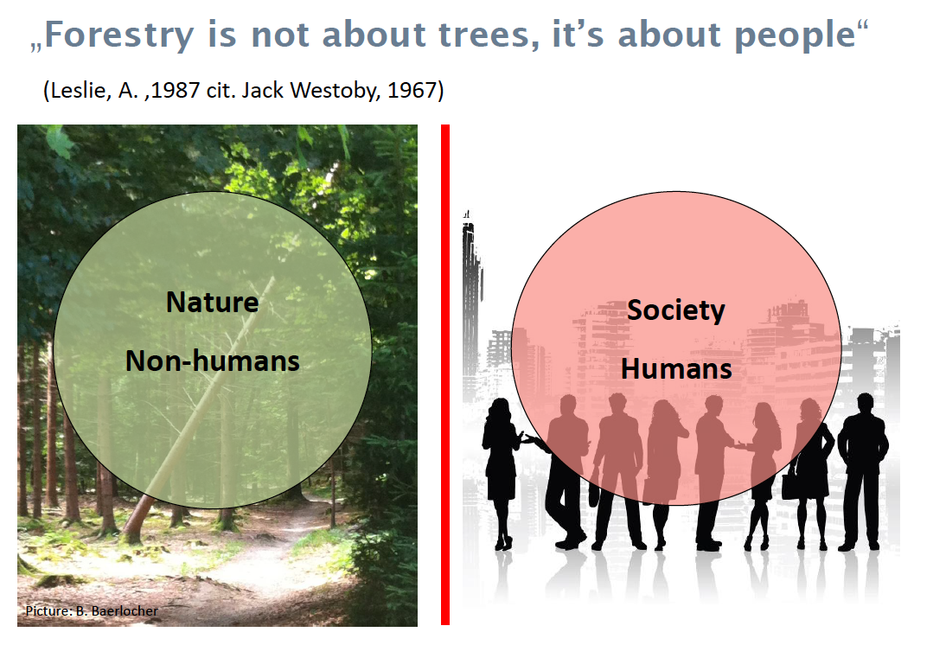

Slide 4
Forests and sustainable cities
Forests and sustainable cities
https://www.youtube.com/watch?v=ucXz3EqzRLo&feature=youtu.be
http://www.fao.org/
http://melbourneurbanforestvisual.com.au/#mapexplore

Slide 5
Greenmaker – kids make cities greener
Problem
  Children under representated in greenspace decision making
  No gardening or rare forest visits during school time
  Only few green school grounds
  Early green space education missing
Project and it’s value
  Children shape the green spaces in the city togehter with city gardeners
  Intragenerational activity of school classes
  Eatable plants trees and fruits

Slide 6
from «so called» participation to «true» participation
Problem
  Not all interest and user groups can participate
  How to represent the «silent» actors?
  How to structure participation processes and learn about the needs of stakeholders
Project and it’s value
  Analysing participation processes in different countries and compare them
    Taking part of participation process e.g. forest development plans under before describes analytical criteria
    Respecting diversity and gender aspects
  Developing «good practice» example on EU-level for UF governance

Slide 7
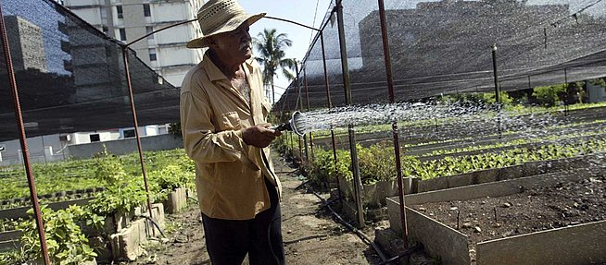

Slide 8
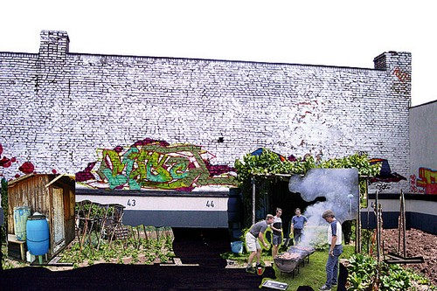

Slide 9
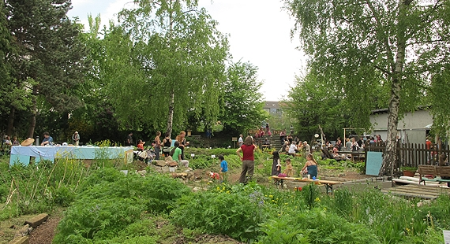

Slide 10
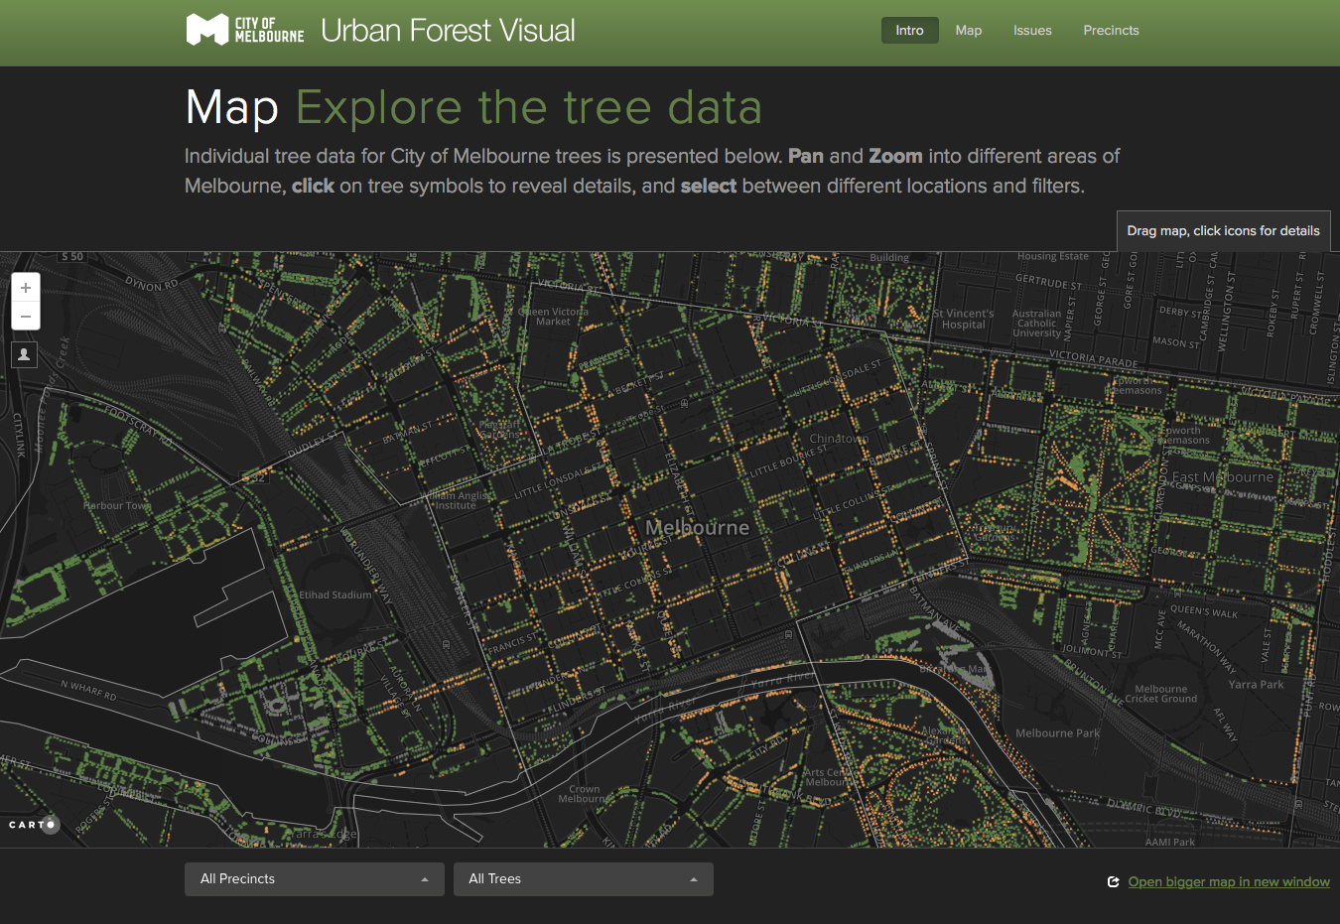

Slide 11
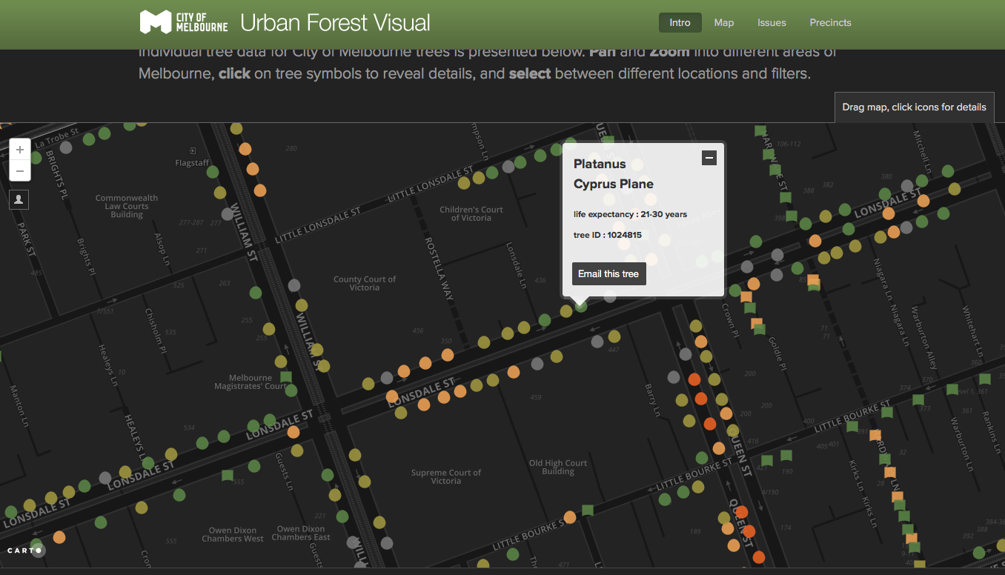

Slide 12
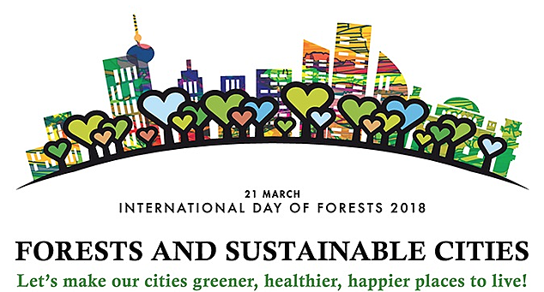
Our Goal!

Slide 13
Thank you very much for your attention.
FHO University of Applied Sciences of Eastern Switzerland

