Slide 1


Master Pedagogy / Urban Education
Developments in
Social Work
April 30th 2018
Kitt Bosman MHOB
of applied Science

Slide 2

City Pedagogy/Urban education
Trends in Public Spaces
Notes:
What do we do and why?

Slide 3
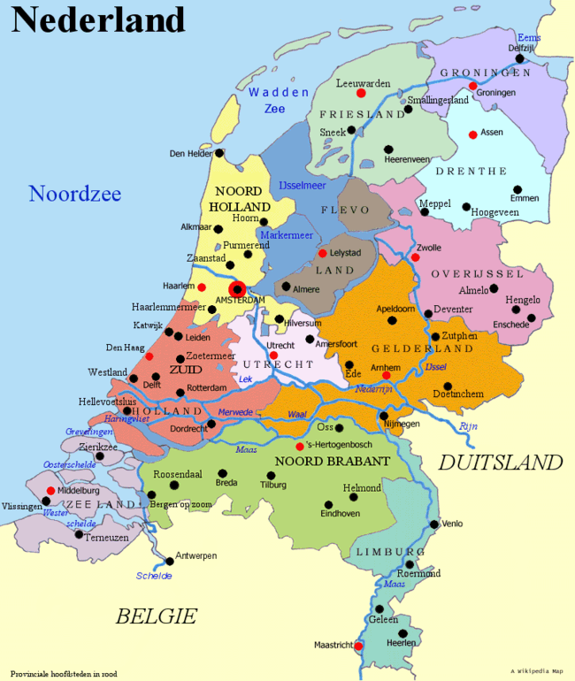
Professional masters in the Netherlands
7 professional masters pedagogy
7 different perspectives
In Rotterdam we choose
Social-pedagogical perspective
“city pedagogue”
Because of the facts:
- Big city
- Rejuvenation
- Urban context of Rotterdam

Slide 4
Competences of a ‘city pedagogue’
networking & connecting
research skills and attitude
contextualizing
communicating
leadership
professionalizing
Notes:
Being present – getting off
Group concern - common goods
Thinking along – critical friend
System –field knowledge
Binding – Sharing
Reflective practitioner

Slide 5
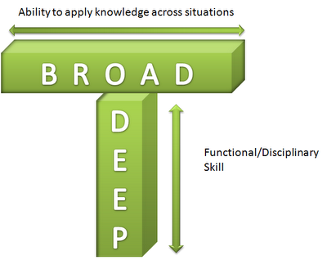


Professional Master Pedagogy
Post-bachelor master for professionals in education, welfare, youth care, healthcare, policing …
Why professional Master?
- Influencing and making policy
- Implementing new programs
on social pedagogical issues in urban context

Slide 6
History of social work
Period
Before WOII | Start social work in North Volunteers and charities
‘50/70 | Rebuilding: welfare state and institutions
‘80 | Crisis, cuts, upscaling
Mid ‘90 | Economic rise: social investments
‘00 | Crisis / Social Reform Act (2007)
2015 | Decentralisations

Slide 7
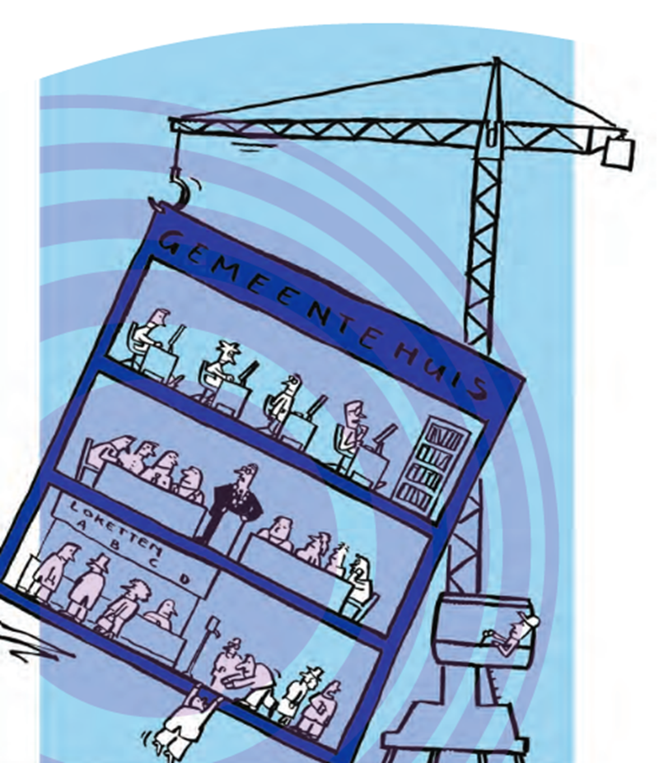
Trends in the Netherlands
High expenses care and welfare
Bureaucracy
Poor collaboration
Mattheus-effect (1975, Deleeck)
Normalisation
Market mechanism / Tenders
Cuts

Slide 8







2015 Transition & Transformation
Transition Transformation
Why?
Closely to the citizens
Too expensive -> 1st line: 20% 2nd line: 80 %

Slide 9
Main principles:
Compensation Principle:
no claiming anymore
Each local government decides their way to support
Participation society:
self reliance and active citizenship

Slide 10
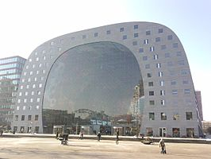
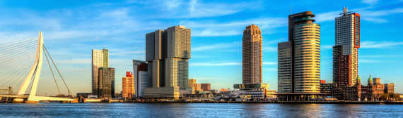
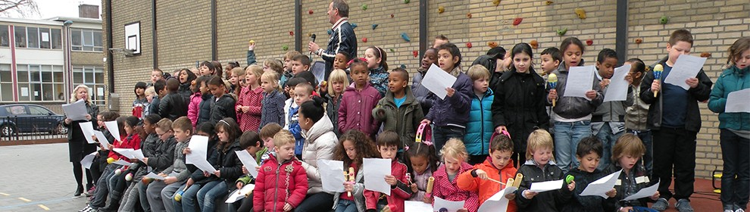
Rotterdam
Fot0s invoegen

Slide 11
Consequences policy and cuts
Rotterdam Welfare
Transformation elderly homes
Number of day care activities decreased
Community centers closed down
Low level of local social services
-> high pressure on neigbourhoods
New opportunities, niches, innovations, …
- Tendering: new assignment & organizations
- New initiatives: Leeszaal West

Slide 12
Tendering (Engbersen, Lupi, 2015)
3 pilot areas
a. efficiency and quality
b. collaboration government / profs / citizens
Better way to show are values
New methodes
Better way to keep control on the quality
Needs / Long term results?
Relations?!

Slide 13
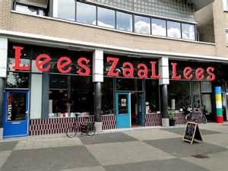
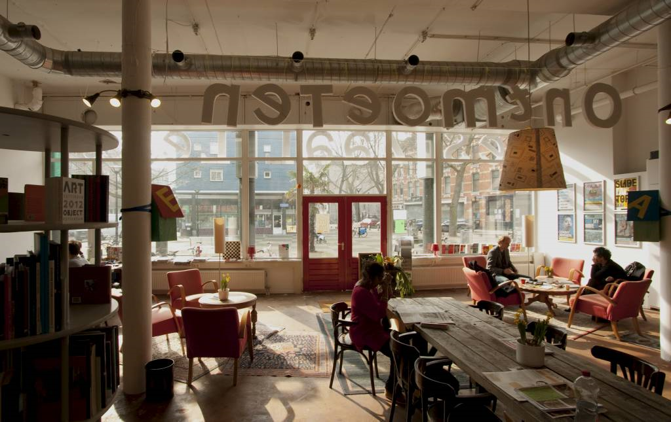
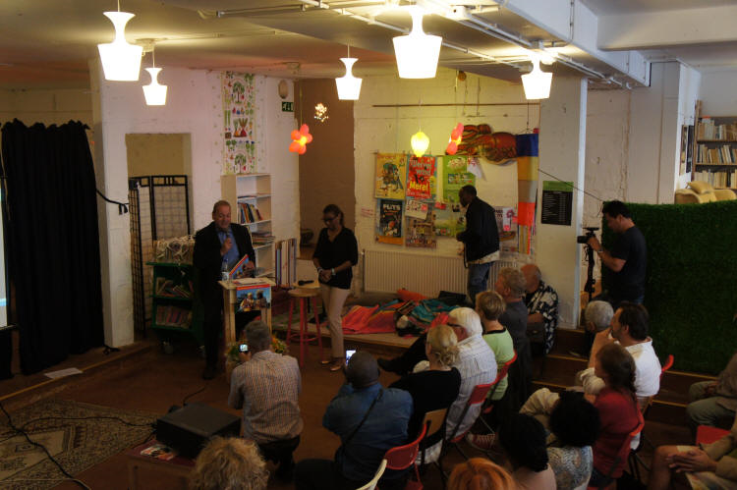
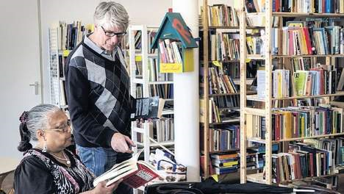
Hurray.. evidence
Self reliance & Active Citizenship
is working!

Slide 14
Critical debate
Believers
Critici:
Due to Middleclass:
selfemployed enterpreneurs
Gentrification: new hotspots for hipsters.
Less interesting neighbourhoods are excluded
Government and professionals are not needed.
Initiators:
“Don’t make this local initiative to a standard norm. Be aware of the complexity”

Slide 15
Conditions
Public familiarity (Miller, 1997)
Vital strong network (Uitermark, 2014)
Social skills, creative, selfconfidence and assertive (Bochhove et al., 2014).
Be aware of assumptions
eg: in poor areas no ground for active citizenship
New rules that fits he new context

Slide 16
City as Text practical field research
Principles of CaT
Mapping
Observing
Listening
Reflecting
Assingment
Look at your area with the following questions in mind:
- Where do people go, why do they go there, and how do they get there?
What feeling do you get about people as you watch them?
Eavesdropping
- Make sure that you are conscious of your own biases, the lenses through which you are seeing and judging, and that you investigate them as thoroughly as you investigate the culture you are studying.
Make notes for concluding discussion

